Slide 1

Introduction to Rendering
CS 418: Interactive Computer Graphics
UNIVERSITY OF ILLINOIS AT URBANA-CHAMPAIGN
Eric Shaffer

Slide 2
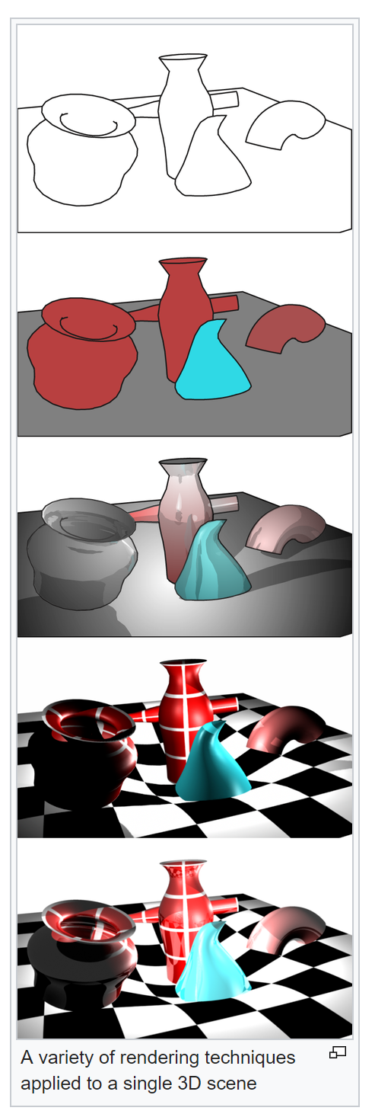
Rendering
Rendering or image synthesis is the automatic process of generating a photorealistic or non-photorealistic image from a 2D or 3D model (or models in what collectively could be called a scene file) by means of computer programs. Wikipedia
What is the same about each image at the right?
What is different?
What technology enables this change in modern real-time graphics?

Slide 3
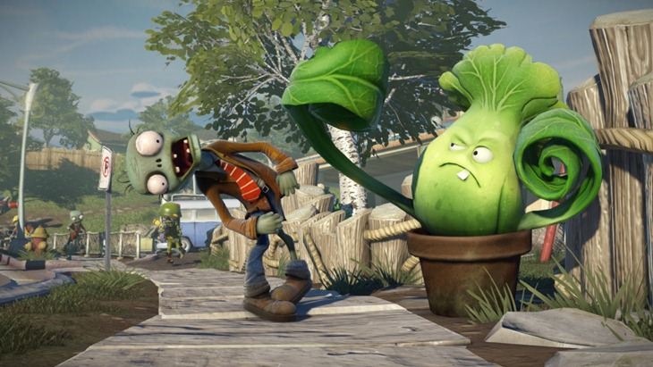
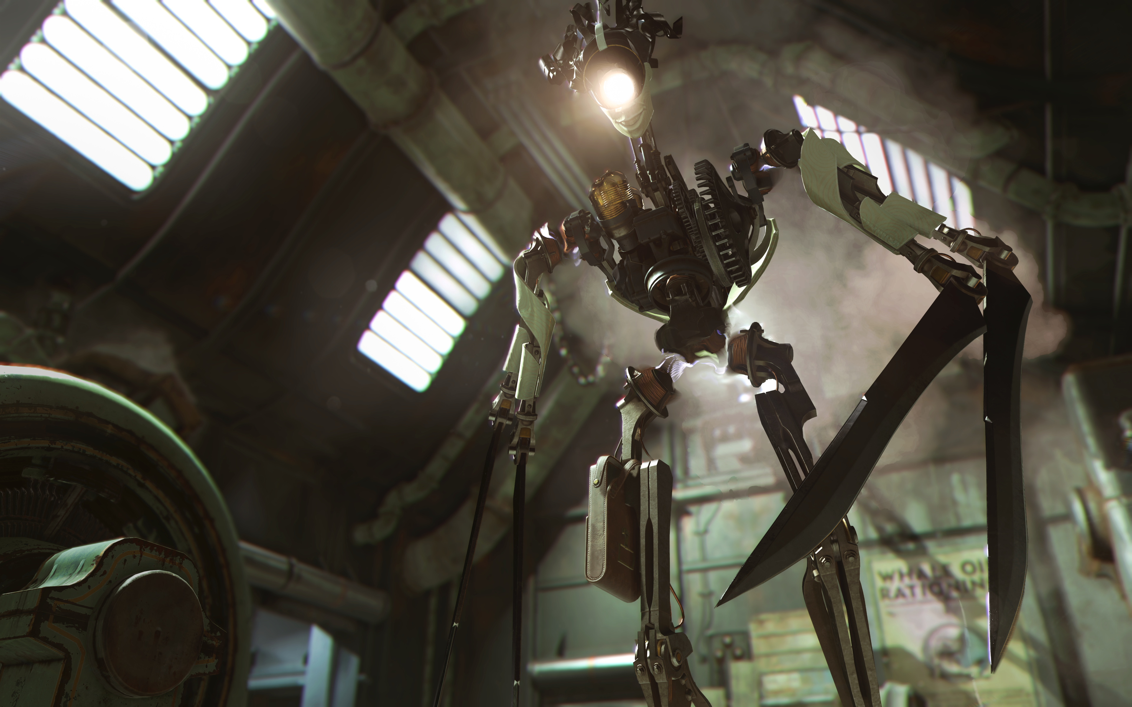
Computer Graphics is Used By…
Video Game Industry
Revenue of more than $100B globally in 2018

Slide 4
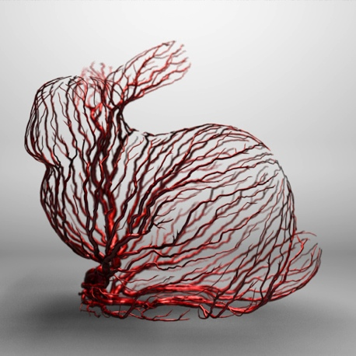

Computer Graphics is Used By…
Medical Imaging and Scientific Visualization
Imaging one of the biggest advances in medicine
Sci Vis allows people to see previously hidden phenomena

Slide 5
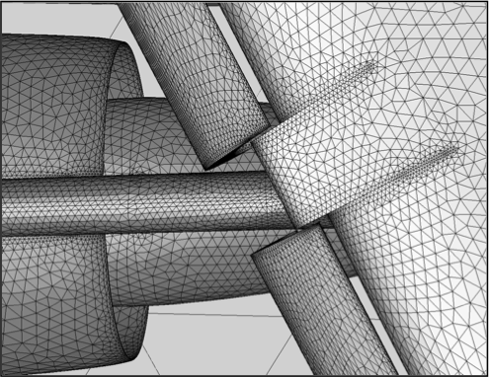
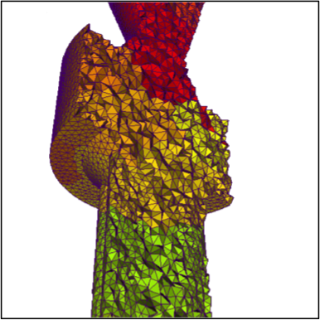
Computer Graphics is Used By…
Computer Aided Design
Engineering, Architecture, the Maker movement

Slide 6
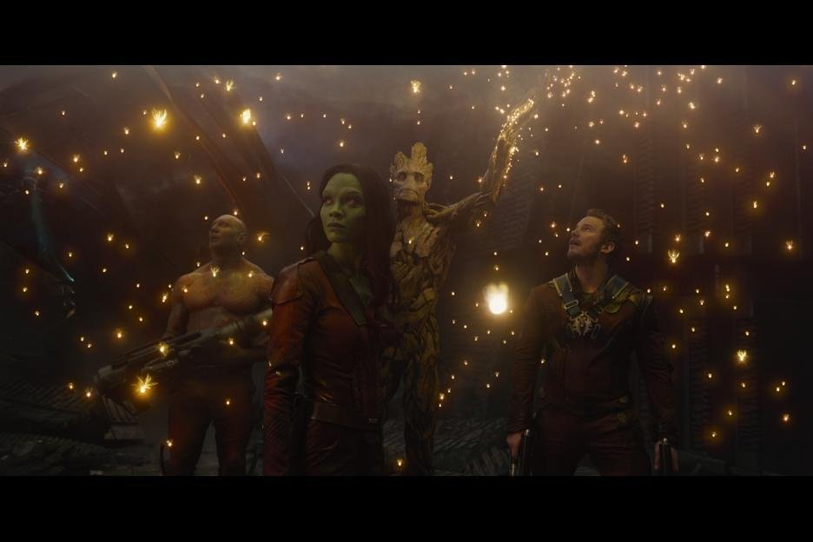

Computer Graphics is Used By…
Movie Industry
Production computer graphics…non-interactive (CS 419)

Slide 7
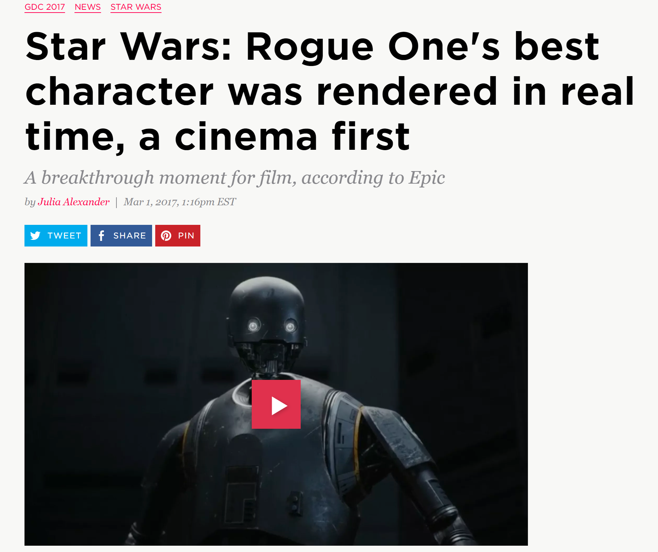
Although…Production CG is Changing…
Why would this be useful when making a movie?
Why is the speedup in producing the scene greater than just the one time speedup of real-time over production?

Slide 8
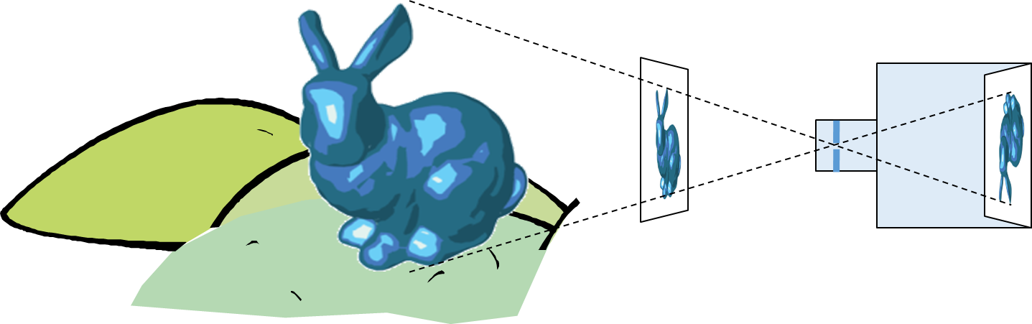
3D Graphics: Image Formation
Goal in CG (usually)is to generate a 2D image of a 3D scene…
The input data is a scene description
Output is an image
To achieve this we computationally mimic a camera or human eye
In the scene…there are objects…lights…and a viewer

Slide 9
“Chlorophyll”
Light is EM radiation
Usually multiple wavelengths
mixed together in a power spectrum
The spectrum sensed by our eyes gets modified multiple times.
Human perception of color relies on 3 different cell types that sense different regions of the spectrum

Slide 10


Synthetic Camera Model
How can we computationally mimic a camera? What specific data would you need? What specific computations would you perform?

Slide 11
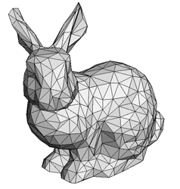
Polygonal Models
Our digital representation of a scene will primarily use polygonal models

Slide 12

Pixel Discretization

Slide 13

Rendering methods generally use one of two approaches
Rasterization (focus of CS 418)
Ray Tracing (focus of CS 419)
Though, sometimes you can use both….
…and the are other methods like radiosity
By Gilles Tran - http://www.oyonale.com/modeles.php?lan

Slide 14
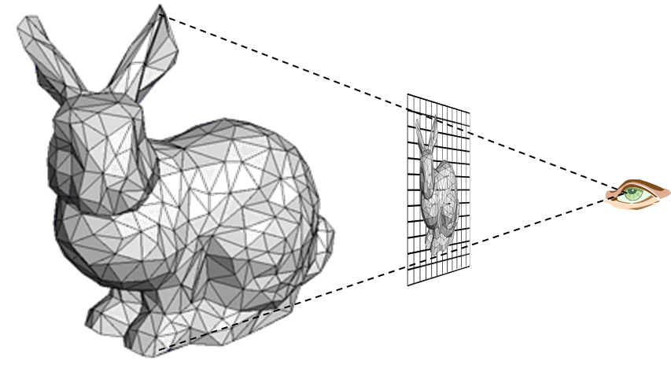
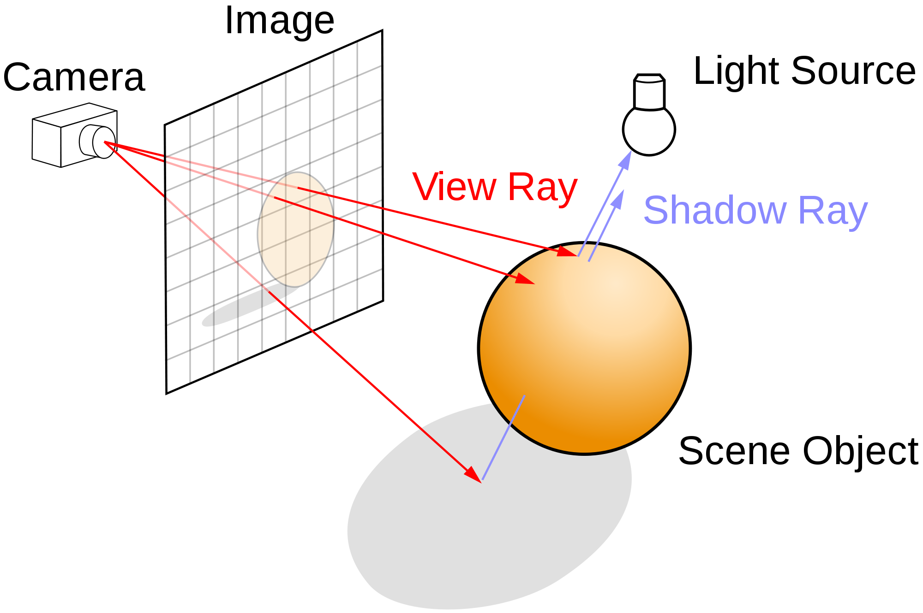
Rasterization versus Ray Tracing
To oversimplify….
In rasterization, geometric primitives are projected onto an image plane and the rasterizer figures out which pixels get filled.
In ray-tracing, we model the physical transport of light by shooting a sampling ray though each pixel in an image plane and seeing what the ray hits in the scene

Slide 15
Ray Tracing
Follow ray of light….
Can trace from an eyepoint through a pixel
See what object the ray hits…
How would you check to see if the object is lit or in shadow?

Slide 16
Rasterization
For each primitive:
Compute illumination
Project to image plane
Fill in pixels

Slide 17
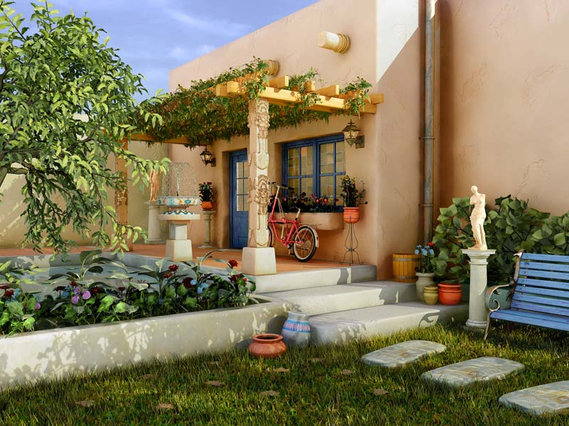
Global versus Local Illumination
For true photo-realism: We cannot compute color or shade of each object independently
Why?

Slide 18
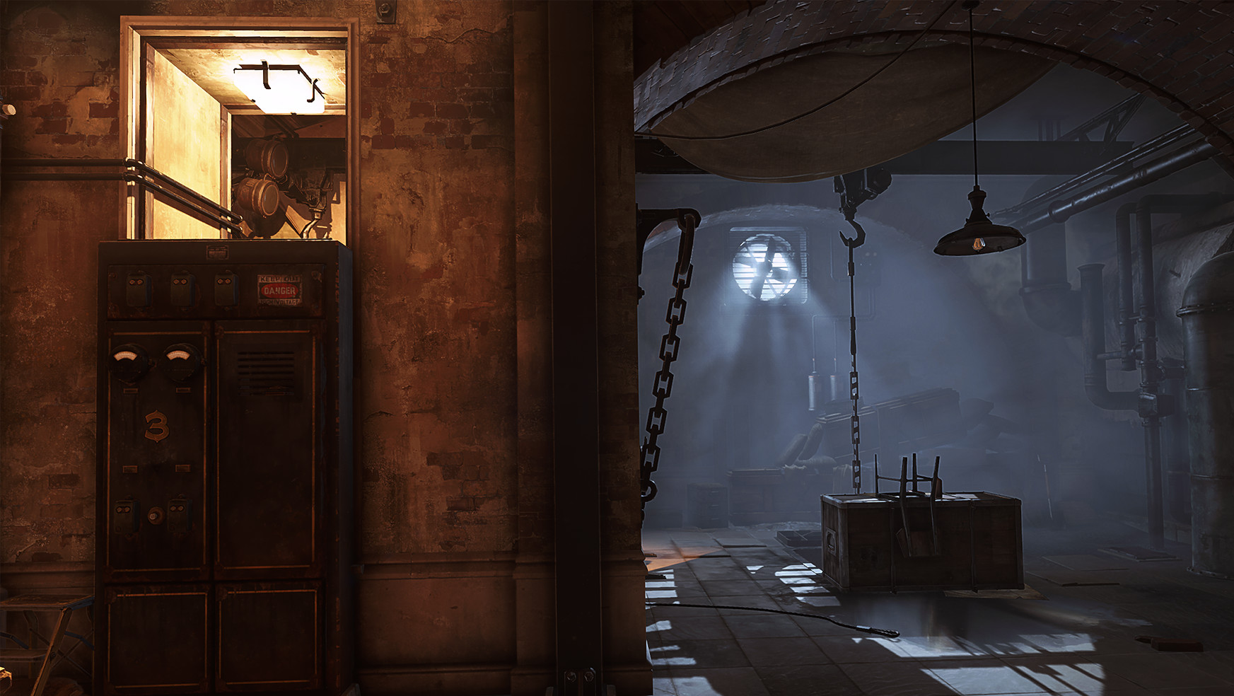
Some objects are blocked from light
Light can reflect from object to object
Some objects might be translucent
Can rasterization produce global lighting effects?
Can ray tracing?
The big advantage of rasterization is…?

Slide 19
Rasterization Engines
Most low-level graphics libraries use a camera model
API typically requires you to specify
Objects in the scene
Materials the objects are made of
Viewer (position, view direction, field of view,…)
Lights - what parameters do you think typically are used?
The engine (i.e. the library) will use pipeline-style processing
The input geometry flows through several processing stages
API = Application Programming Interface

Slide 20
Definitions: Pixel and Raster
A pixel is the smallest controllable picture element in an image
A raster is a grid of pixel values
Typically rectangular grid of color values
(1.0, 0.0, 0.0), (0.0, 0.0, 1.0)
(0.0, 0.0, 1.0), (1.0, 0.0, 0.0)
RGB Color Representation A color is a triple (R,G,B) representing a mix of red, green, and blue light. Each color channel has a value in [0, 1] indicating how much light is emitted.

Slide 21
Rasterization
Primitives
Pixels
Vertices
Edges
Generate a raster image from a vector description
Aliasing
Vector Graphics Representation Is a purely mathematical representation of shape. For example, a line is y=mx+b. Typically, vector graphics refers to 2D shapes, but the idea applies to 3D as well.

Slide 22


3D Graphics Pipeline
Vertex Processing
Rasterization
Fragment Processing
Fragments Are like pixels…but they aren’t necessarily the finalized pixels you see in an image.
Each fragment has a 2D location in a raster and a color. Final pixel value is typically found by applying hidden surface removal and possibly compositing to a set of fragments.

Slide 23
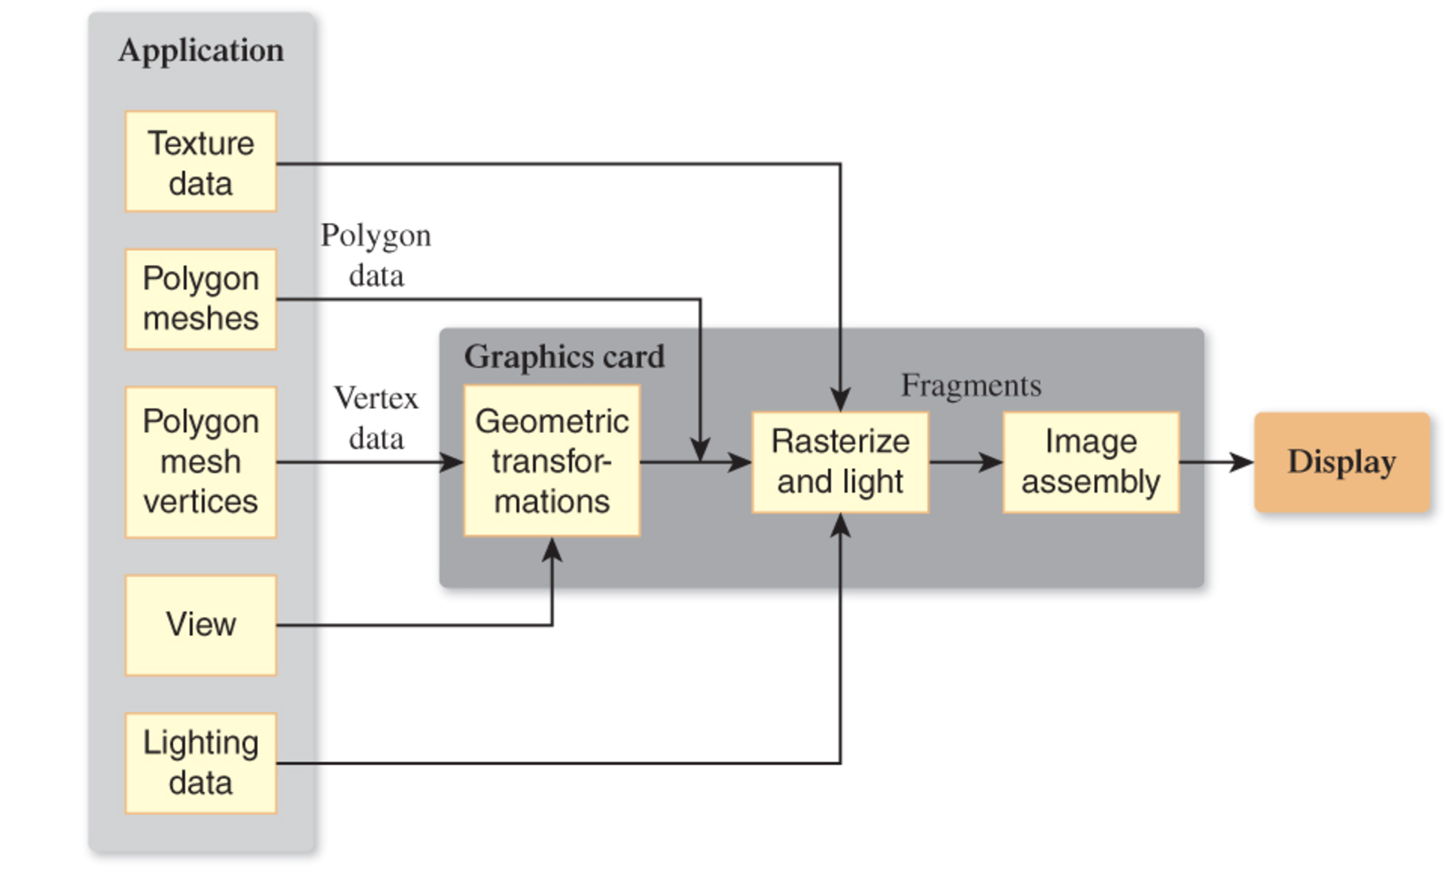
Rasterization is a Pipeline
Data for objects in the scene usually in the form of polygonal meshes
Most of the work to render an image is done on the Graphics Processing Unit (GPU)
GPU code will have at least two parts
Vertex Shader
Fragment Shader

Slide 24
Vertex Shader
Program that runs on the GPU
Typically transforms vertex locations from one coordinate system to another
Transformations can be useful for placing objects in your scene
Also, some operations on the geometry are easier when done in specific coordinate system
Change of coordinates usually equivalent to a matrix transformation
Vertex shader can also computes vertex colors

Slide 25
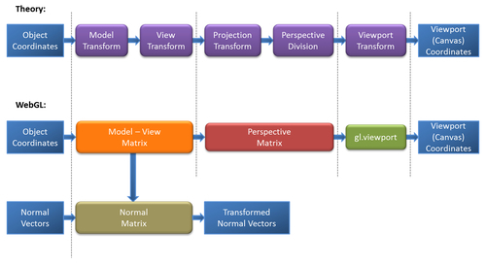
Changing Coordinate Systems
Model Transformation: Move a model from a local coordinate system to a position in the “world”
View Transformation:
Keeping camera fixed, move all the objects in the world so that they are seen as if from a specific viewpoint
Projection Transformation: Change coordinates so that a 3D to 2D projection of the geometry is done correctly
Viewport Transformation: Change from 2D coordinates in [-1,1] to pixel coordinates

Slide 26
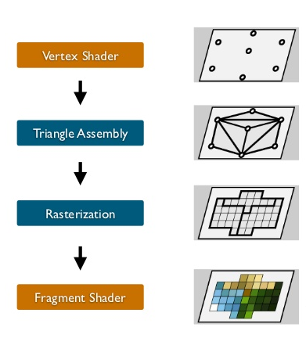
Pipeline Step: Primitive Assembly
Vertices must be collected into geometric objects before clipping and rasterization can take place
For WebGL: Points, Line Segments, Polygons
Other APIs sometimes support more complex geometry (e.g. curves)

Slide 27
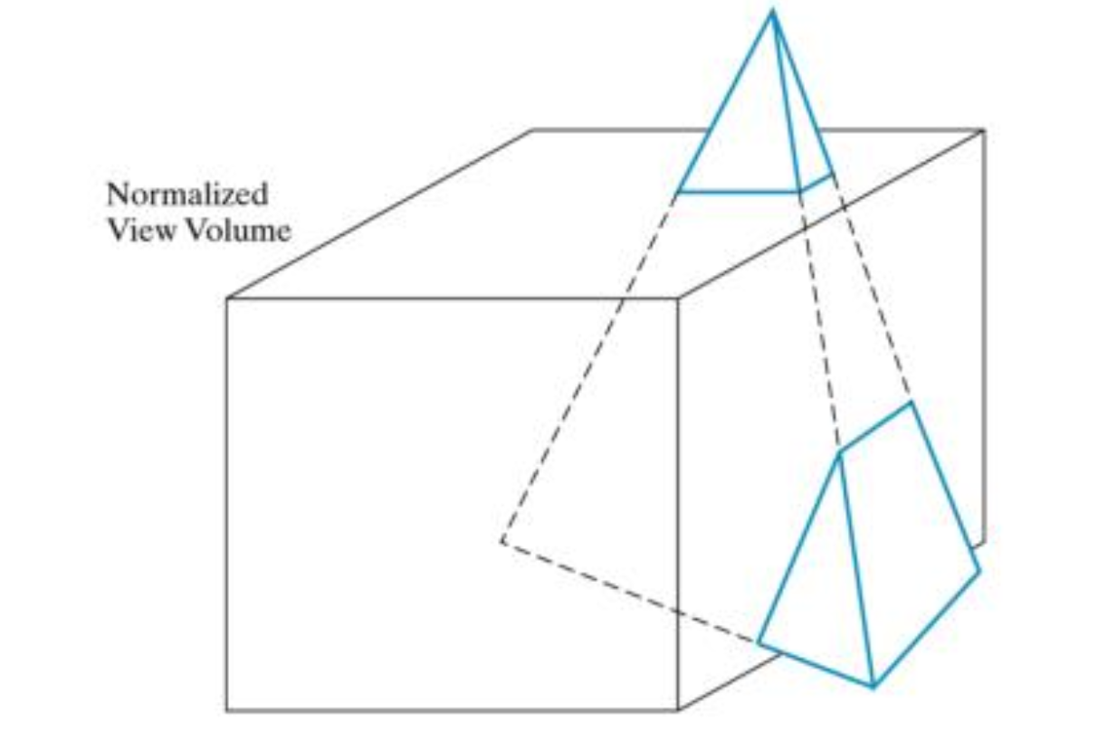
Pipeline Step: Clipping
Our virtual camera can only see part of the world
Objects not within this volume are said to be clipped out of the scene

Slide 28
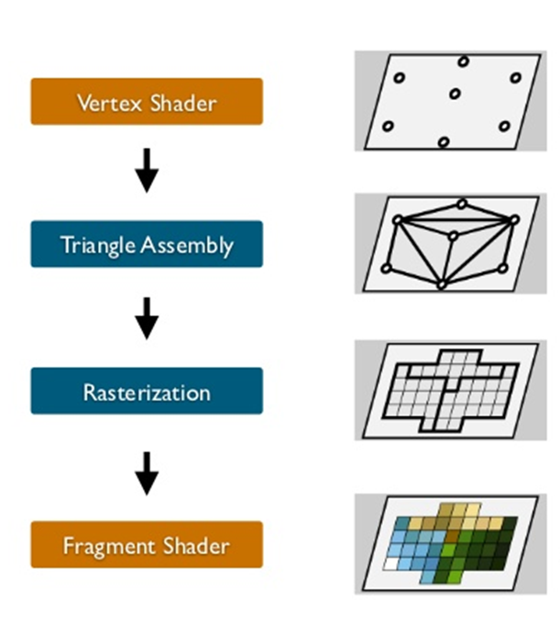
Rasterization
If an object is not clipped out, pixels in the frame buffer must be assigned colors
Rasterizer produces a set of fragments for each object
Fragments are “potential pixels”
Have a location in frame buffer
Color and depth attributes
Vertex attributes are interpolated across fragments

Slide 29
Pipeline Step: Fragment Processing
Fragment shader computes color of the fragment
Fragments are processed to determine the color of final pixel
Fragments at same location may need to be composited
Is a fragment blocked by other fragments closer to the camera?
Hidden-surface removal

Slide 30
The WebGL Rasterization Engine
WebGL relatively new (2011) 3D graphics support for web
WebGL advantages
runs in browser
naturally cross-platform
don’t need to obtain/build other libraries
gives you “windowing” for free
easy to publish/share your stuff
Disadvantages
Depends on how you feel about JavaScript
Performance can be tricky
Pretty low-level

Slide 31
Programming Language for CS 418
HTML
JavaScript
WebGL
WebGL version of the GLSL shading language (runs on GPU)
Chrome as default browser
Chrome DevTools to debug code
Some WebGL examples: https://www.chromeexperiments.com/webgl

Slide 32
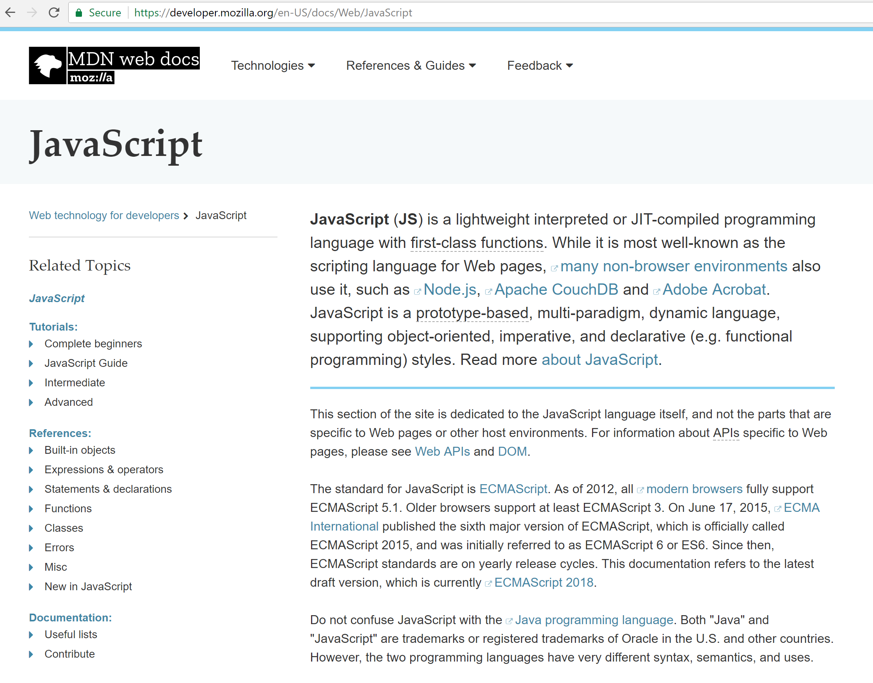
JavaScript
We will provide example code
You are responsible for learning what you need to complete the assignments
Mozilla reference/tutorials are quite good
https://developer.mozilla.org/en-US/docs/Web/JavaScript

Slide 33
What is WebGL? Let’s start with a word about OpenGL
Open standard for 3D graphics programming
Developed by Silicon Graphics in 1992
Available on most platforms…
Bindings available for lots of languages…
It’s low level
“Windowing” typically requires another library
e.g. GLUT
Version 3.0 (2008) introduced programmable shaders
Deprecated fixed-function pipeline
Vulkan API is the successor technology (still pretty new…2016ish)

Slide 34
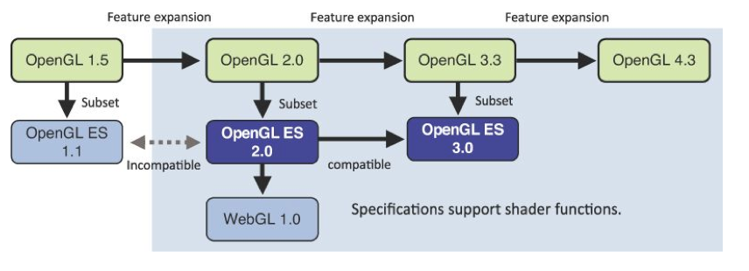
WebGL is not exactly OpenGL
Figure from WebGL Programming Guide: Interactive 3D Graphics Programming with WebGL by Matsuda and Lea

Slide 35
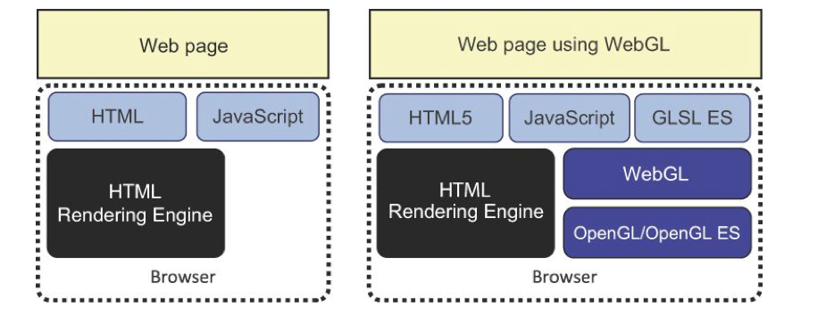
WebGL Application Structure
Figure from WebGL Programming Guide: Interactive 3D Graphics Programming with WebGL by Matsuda and Lea
Your application will generally just have HTML and JavaScript files

Slide 36
WebGL and GLSL
WebGL requires you provide shader programs
GLSL OpenGL Shading Language
C-like with
Matrix and vector types (2, 3, 4 dimensional)
Overloaded operators
C++ like constructors
Similar to NVIDIA’s Cg and Microsoft HLSL
WebGL functions compile, link and get information to shaders

Slide 37
Shaders
Shader source code will be in the HTML file or a JS file…usually
Vertex Shaders generally move vertices around
Projection, animation, etc.
Assign a value to the built-in variable gl_Position
Fragment Shaders generally determine a fragment color
Assign a value to the built-in variable gl_FragColor

Slide 38
Simple Vertex Shader
input from application
attribute vec4 vPosition;
void main(void)
{
gl_Position = vPosition;
}
must link to variable in application
built in variable

Slide 39
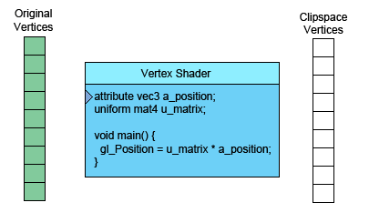
What a Vertex Shader Does…
Taken from webglfundamentals.org
Can you guess what is slightly incorrect about this animation?

Slide 40
Simple Fragment Program
precision mediump float;
void main(void)
{
gl_FragColor = vec4(1.0, 0.0, 0.0, 1.0);
}

Slide 41
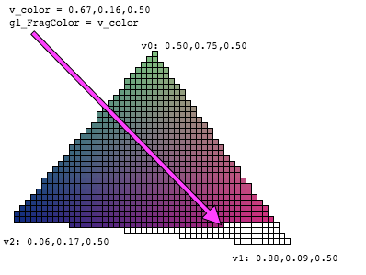
What a Fragment Shader Does…

Slide 42
Processing on a GPU
The Graphics Processing Unit (GPU) will have a large number of cores.
This architecture supports a massively-threaded environment for processing vertices and fragments (think of fragments as pixels for now)
Image from http://antongerdelan.net/opengl/shaders.html

Slide 43
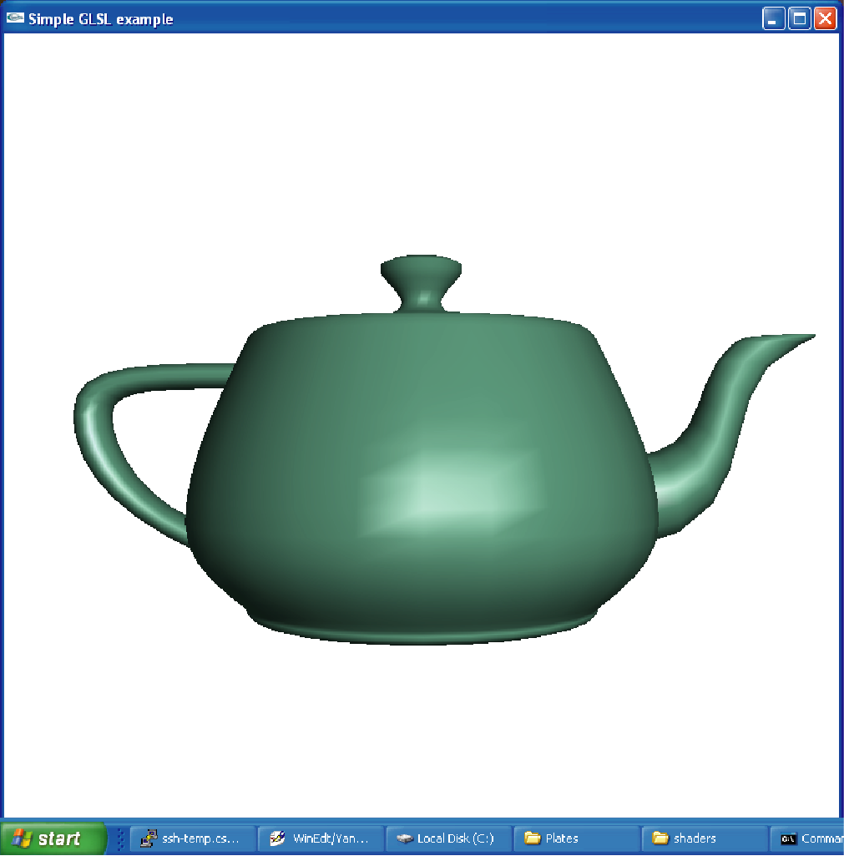
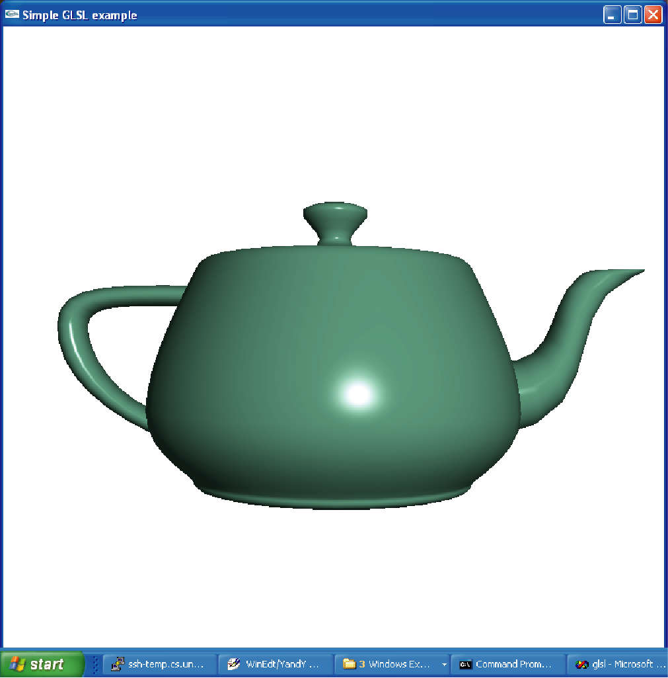
Shading
Shading The process of generating a color using lighting and material information
You can do this in either vertex shader or the fragment shader
Why does per-fragment shading look more realistic?
per vertex shading
per fragment shading

Slide 44
From Today: What Should You Know?
General principles of rasterization
Pipeline model of a rasterization engine
What a vertex shader does
What a fragment shader does
Difference between rasterization and ray-tracing

Slide 45
CS 418…About the Course
Interactive Computer Graphics
Focus on algorithms and techniques used in rasterization
Rasterization is fast enough for real-time complex 3D rendering
The course will teach you how to use WebGL
Web-based rasterization engine
Similar features to many other technologies (e.g. OpenGL, Vulkan, D3D)
We will also cover fundamental graphics algorithms
Things like line drawing that reside inside the WebGL library

Slide 46
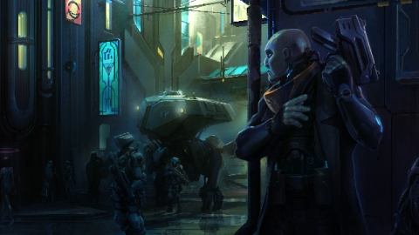

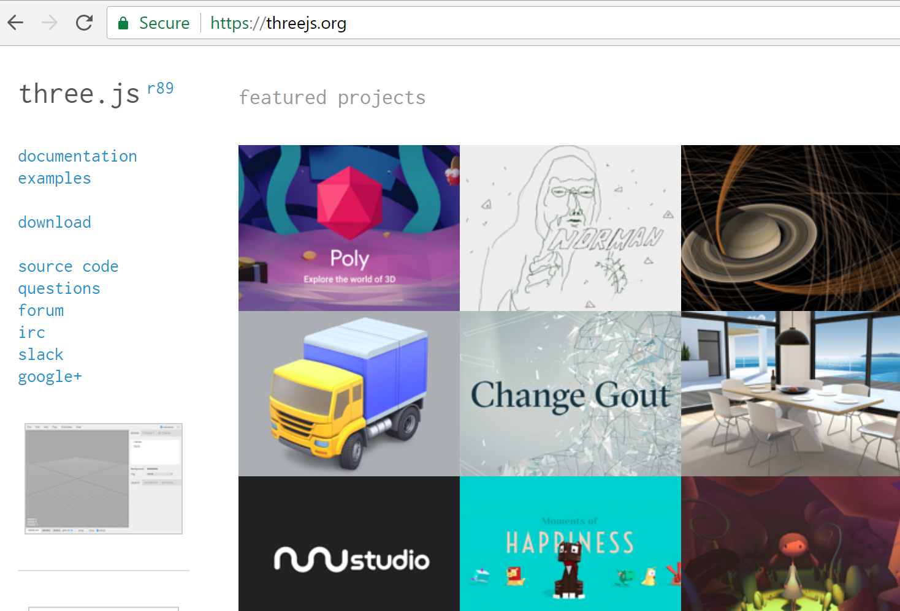
Things you would not use WebGL for..
Making a Game
Typically would use a game engine like Unity or Unreal
Making a Movie
Renderman
3D Web App Development
three.js which is built on WebGL
But to use three.js you need to understand WebGL
And, basic CG concepts need to be understood to use Unity or Renderman as well…

Slide 47
Class Mechanics
Course Website: https://courses.engr.illinois.edu/cs418
Schedule, lecture materials, assignments
Piazza: This term we will be using Piazza for class discussions https://piazza.com/illinois/spring2020/cs418/home.
Grades available on Compass

Slide 48
Things we aren’t doing….
No Final Exam

Slide 49
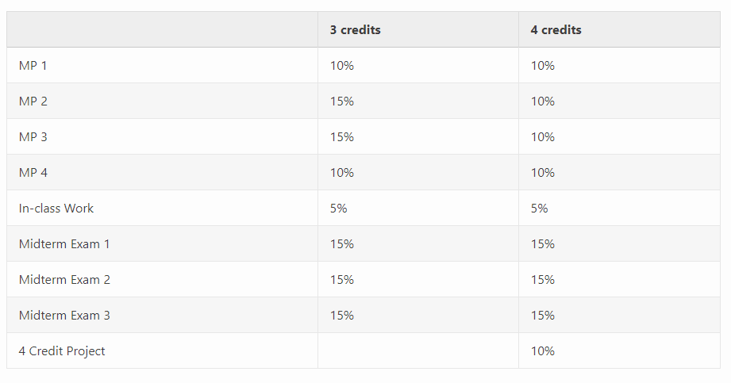
Things we are doing

Slide 50
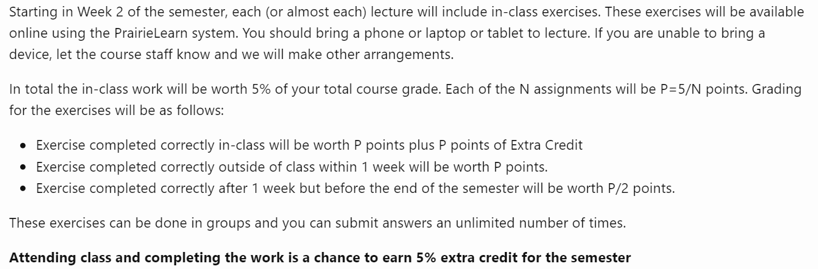
In-Class Work

Slide 51
Grading Scale
Grades probably on usual scale:
98 to 93: A
93 to 90: A-
90 to 87: B+
87 to 83: B
83 to 80: B-
…etc.
I may adjust the intervals down…but not up.

Slide 52
4 Credit Students
If you are taking the course for 4 credits, you will complete an extra project implementing real-time transformation of web content for accessibility. The projects will be done in groups and we will release details by Week 3.

Slide 53
Course Policies
MPs submitted after the due date lose 10% per day
In exceptional circumstances where extension may be reasonable (illness, family emergency etc.) arrangement must be made with the instructor e-mail: shaffer1@illinois.edu
Discussing code is fine, copying code is not… If we discover plagiarized code,
that code will receive a grade of 0
your total course grade will be dropped by one letter grade
Do not use 3rd party code or copy and paste code you find randomly on the web
Just to be clear: Type the code yourself. If you are using existing code as reference, change it up when you type it
Exams are in the Computer-Based Testing Facility (CBTF)
Post technical questions to Piazza Do not post your code visible to other students Do not expect us to debug your code (we will try to help….)

Slide 54
Class Mechanics: No Book
We’ll post notes online
It will save you $150
Language References and Resources
JavaScript/HTML/CSS: https://developer.mozilla.org/en-US/docs/Web/JavaScript
WebGL Specification: https://www.khronos.org/webgl/
WebGL Tutorial: https://developer.mozilla.org/en-US/docs/Web/API/WebGL_API
Suggested Editors: Brackets
Chrome DevTools Overview: https://developer.chrome.com/devtools

Slide 55
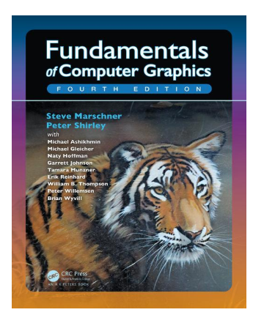
Suggested Books
Fundamentals of Computer Graphics 4th Edition by Steve Marschner, Peter Shirley Deals with the theoretical and mathematical aspects of computer graphics. Very readable. UIUC Library E-book link

Slide 56
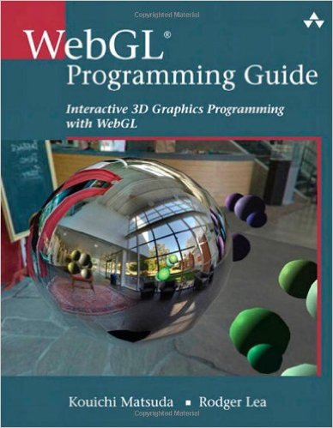
Suggested Books
WebGL Programming Guide: Interactive 3D Graphics Programming with WebGL (OpenGL)Jul 19, 2013
by Kouichi Matsuda and Rodger Lea

Slide 57
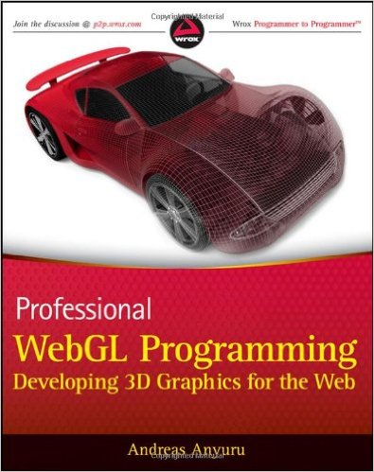
Suggested Books
Professional WebGL Programming: Developing 3D Graphics for the Web May 8, 2012
by Andreas Anyuru

Slide 58
Course Topics
Course Topics
IMAGING — how do computers store images?
GEOMETRY — how do we represent shape?
RENDERING — how do we simulate light?
ANIMATION — how do we synthesize motion?

Slide 59
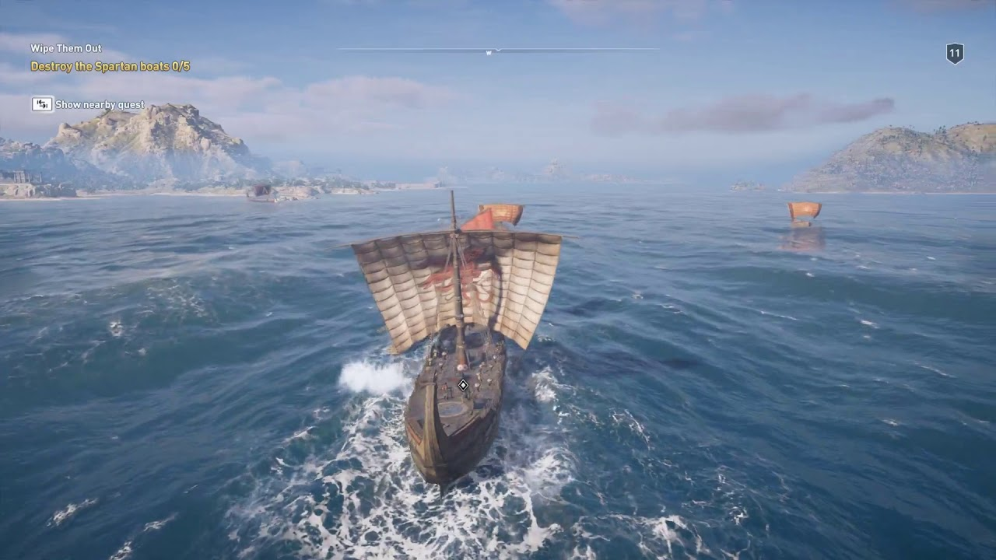
Course Topics
IMAGING — how do computers store images?
GEOMETRY — how do we represent shape?
RENDERING — how do we simulate light?
ANIMATION — how do we synthesize motion?

Slide 60
Some WebGL
https://artsexperiments.withgoogle.com/bagan
https://paveldogreat.github.io/WebGL-Fluid-Simulation/
http://david.li/fluid/

Slide 61
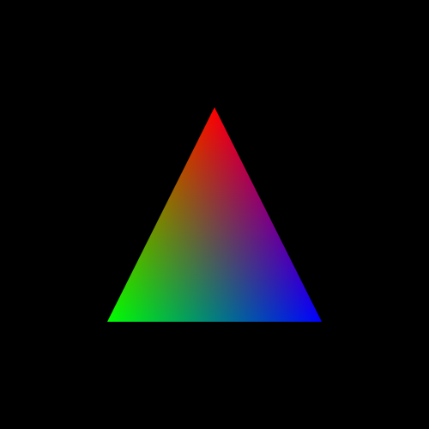
We will start with

Slide 62
For Next Class
If you have a laptop or your own PC
Install an editor (e.g. Brackets)
Install a browser supporting WebGL (e.g. Chrome)
Verify WebGL runs in that browser on your machine https://illinois-cs418.github.io/Examples/HelloColor.html https://illinois-cs418.github.io/Examples/HelloColor.js
Try changing the code…different color…different shape
If you don’t have your own computer, try an EWS lab

